Slide 1

DEEP DIVE OF HOUSING IN INDIA
By-
Sahil Joshi
Chetan Jagadeesh
Pulkit Pradeep Gupta
Kshitiz Pradeep Gupta

Slide 2
Gathering the data
The dataset used for the EDA was gathered from the 2011 Census data from https://censusindia.gov.in
Total 640 csv files were scraped from the website using Beautiful Soup.
These datasets were then merged into a master dataset which was used to gather insights from.
The datasets for the training and predictions was gathered from the Kaggle. All the different metropolitan cities data was merged before splitting into training and testing data.

Slide 3
Workflow
Approach
To gather insights of the current housing conditions in India
To use these insights and predict the Housing Price in major metropolitan cities
Using Linear Regression as a base model.
Trying multiple models like Decision Tree, Random Forest, XGBoost and evaluate the results.
Calculation of Housing Quality of Living Index.
Use 40 different amenities to predict the housing prices.
Objective
Solutions

Slide 4
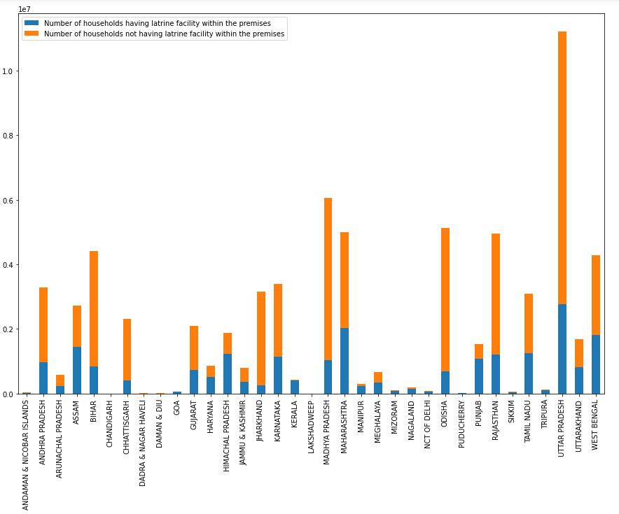
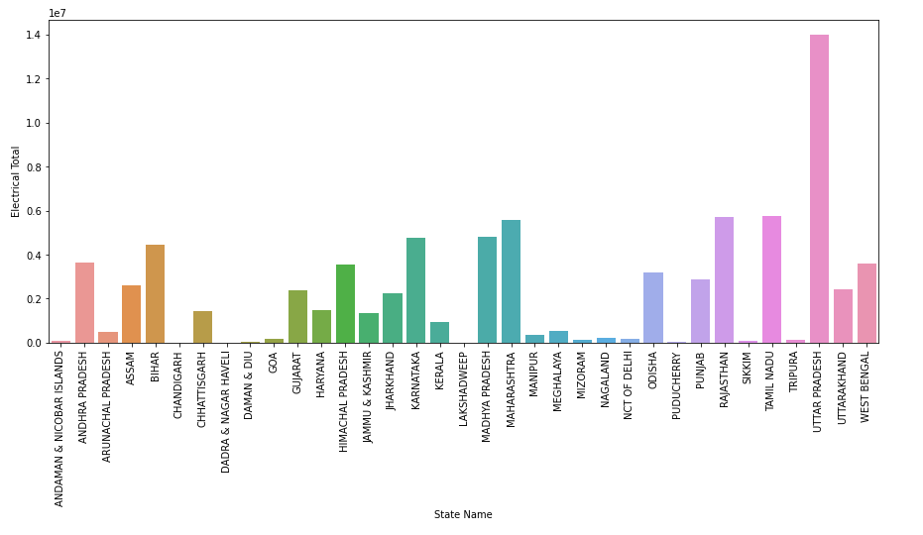
Exploratory Data Analysis
Latrine facility across state
Electrical household items usage across state

Slide 5
Feature Engineering
To assess the household quality of living only for Indian states, a Household Quality of living Index (HQLI) is constructed on the basis of 20 variables. Here, Union Territories (UTs) are excluded to equalize the parity of the states. HQLI is made up of three distinctive indices such as quality of housing index (QHI), basic amenity index (BAI) and asset index (AI).
Since we know that housing prices vary across each city, We plan to create features for model to differentiate each city and make better price prediction.
We created Latitude and Longitude features for each location using geocode.
We also one hot encoded the city names for differentiating houses across the cities.

Slide 6
Linear Regression and Decision Tree
After adding the new features (Housing Quality of Living Index, Latitude, Longitude) to the Kaggle dataset, the final data is split into training and testing dataset.
This data was used to train and evaluate the model with default base model without any parameter tuning.

Slide 7
Random Forest and XGBoost
For the random forest and XGBoost models, we first found the most optimal parameters that gave the lowest oob error.
Using these parameters we trained our final model. On this model we used permutation importance to find the most important features that contribute to the predictions.

Slide 8
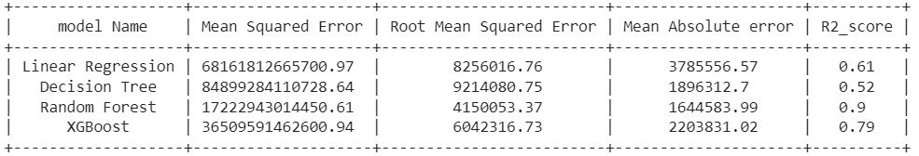
Results
We see that Random forest and XGBoost do much better in prediction when compared to linear regression and decision tree.
Random Forest outperforms all the models with a r2 score as high as 0.9.
The mean absolute error observed states that we are off by 16L which is quite decent when the prices of the house are in Crores.

Slide 9
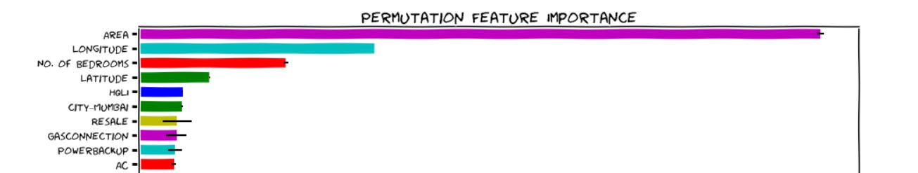
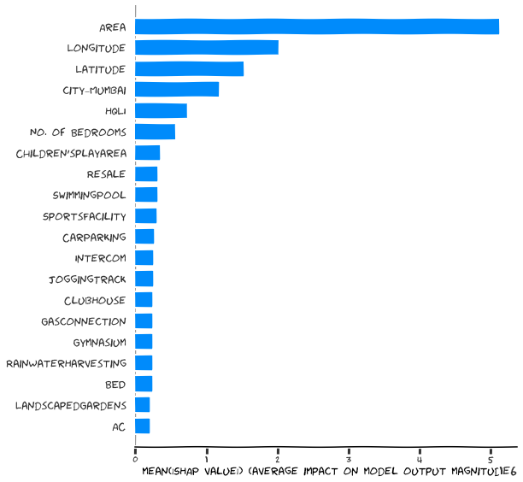
Model Interpretation
Top Features for Random Forest
Top Features for XGBoost

Slide 10
Future work
We would like to explore more models like lightgbm and Neural Networks.
We would try Stacking or cascading techniques and evaluate the performance of such methods.
Probably spend more time creating more features for better prediction.

Slide 11
THANK YOU

